Slide 1

Semester exams
Tips, Tricks, and Strategies to Help You Prepare
Notes:
NOTE:
To change the image on this slide, select the picture and delete it. Then click the Pictures icon in the placeholder to insert your own image.

Slide 2

All About That Test…No Worries ☺
All About That Test Video Clip

Slide 3

Semester Exams

Slide 4

Some Information About Semester Exams
They are comprehensive
You will have one hour
You can exempt one exam during your 6th grade year if you have all A’s in your classes
In 7th grade, you can exempt two
In 8th grade, you can exempt three
It starts over in 9th grade

Slide 5
Before the Test
Understand
Understand what you are studying
Write short notes or summaries
Read out loud
Create Doubts
Ask your teachers for clarity about your doubts
Do a quiz
Online
Trade with a friend
Videos
Search for online videos relevant to the subject
Crash Course is a good one

Slide 6

Study Well
Do not start studying the day before the test.
Prepare a study time table now or this weekend
Be sure to take a break every 15 or so minutes when studying. It refreshes your brain
Do your review
Ask quesitons

Slide 7
Study Well Continued
Ask your instructor the format of the test questions
Ask your instructor what areas or concepts will be highlighted on the test
Go over material from old tests and quizzes
Highlight the concepts you may have struggled with, then go back and pay special attention to them

Slide 8
Memory techniques

Slide 9
Help Your Brain
Do something specific
  Do something while you are studying that you can replicate during the exam
  For example, suck on a certain flavor of mint while you are studying and then take that same kind of mint to the exam
Study with a friend
  One that will help you and not waste your time

Slide 10
Use Mnemonics
These are memory tricks such as the following:
Acronyms like Please Excuse My Dear Aunt Sally
Chaining- creates a story where each idea helps you remember the next one
Keywords: For example, the Spanish word cabina means phone booth. Picture a cab trying to fit in a phone booth and it will help you remember

Slide 11
During the test

Slide 12

The Day Of
Get a good night’s sleep
Eat a good breakfast
Go to the bathroom
Make sure you have pencils, erasers etc before the test
Bring a watch so you can budget your time

Slide 13

When You Get the Test
Do a quick survey of the entire test so you know how to budget your time
Do the easiest problems first. Don’t sit stuck on a problem. Star it, then move on to the problems you know
Do not rush. Read and re-read the directions. Some directions ask for more than one answer
Write legibly. If your teacher cannot read what you wrote, it will be marked as wrong

Slide 14
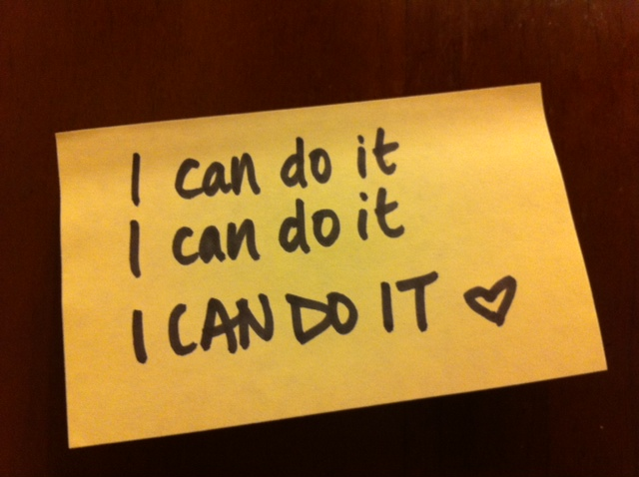
During the Test
Always read the whole question carefully. Do not make assumptions about what the problem is asking
Again, if you get to a question you do not know, mark it and move on. Other parts of the test may jog your memory as you move on
Do not worry about if others finish before you.
If you have time left after you finish, go back through the whole test to make sure you answered all questions

Slide 15
You CAN DO IT!

